Slide 1

MLB PLAYER STATS ANALYSIS
Nikhil Cherukuri, Daniel Guerrero,
Nik Potapov, Brittany Thum

Slide 2


EXECUTIVE SUMMARY
Background and Proposal
Database Development
ER Design: 4 Tables
App Demonstration

Slide 3
BACKGROUND AND PROPOSAL
DATA: Baseball Team and Player statistics from 1901 – 2021
Our app uses 2015 – 2021
WHO: MLB Team Managers
WHAT: MLB Team Game Statistics and Player Statistics from 2015 – 2021
Game Results
At Bats, Home Runs, Strikeouts, etc
WHY: MLB Managers can study their players, how the team performs in games, and which players should they try to sign onto their team.
The goal is to use baseball statistics to have a successful team

Slide 4
DATABASE DEVELOPMENT
Entities:
Team:
Contains the team name and number of players
Player:
Player ID, Player Name, and Team
Game:
Date, Team, Opponent, Result
Date, Team used for relationships
Performance Indicators:
Player ID, Date, and Player Statistics

Slide 5
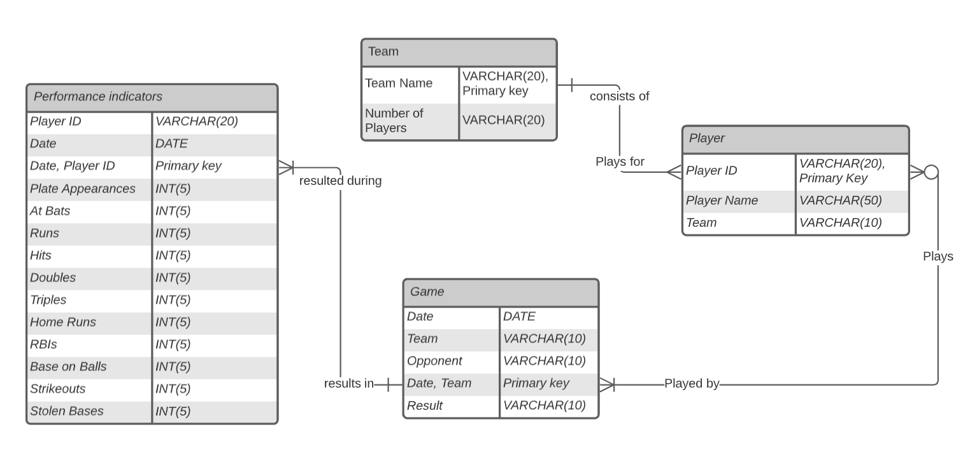
ER DIAGRAM

Slide 6

DEMONSTRATION
https://danielguerrero.shinyapps.io/MLB_DBApp/

